Slide 1
Soft Systems Methodology
Şebnem Açıkyüz
1806942
Notes:
asdasdd

Slide 2
Steps of Soft System Methodology
Data Collection
Analysis
Relevant Systems and Root Definitions
Conceptual Modelling
Comparisons to Provide Debating Agenda
Discussing the Agenda with the Actors
Action for Change

Slide 3
STEP 1 - Data Collection
Purpose : Collect information about the ‘mess’
Same approach as ‘hard system’ and ‘system failures’ methodologies
Interviewing with key figures
Attention to dissatisfaction and concern
Documentary information

Slide 4
STEP 1 - Data Collection
Interviewing key figures
No hard and fast rules for deciding key figures
Typically “Client” and “Problem Owner”
For getting “background information” and “what is going wrong”
Interviews
Non-directive
Open-ended questions (Why? What?)
Avoid leading questions
Must be as neutral as
Must remain confidential

Slide 5
STEP 1 - Data Collection
Documentary information
Minutes of meeting
Reports
Memoranda
Correspondence
Focus on what key figures consider to be important information
Some invaluable documents (too sensitive)

Slide 6
STEP 1 - Data Collection
AFTER data collection process;
Analyst should HAVE
adequate information
ABOUT unstructed problem situation
TO Enable analysis

Slide 7
STEP 2 - Analysis
Starts with drawing a “RICH PICTURE” of the “MESS”
Rich Picture
Analyst’s own interpretive ‘snapshot’ of the ‘mess’
Not a system diagram
Has loose boundaries for ease of understanding

Slide 8
STEP 2 - AnalysIs
From the rich picture
Analyst is able to identify
A number of issues
One or two primary task-related areas
Clues from rich picture are
Symbols and Expressions of
Clashes, pressure and uncertainty

Slide 9
STEP 3 - Relevant Systems and Root DefInItIons
In step 1&2
“What is happening in real word”
In this step
“Consideration of notional systems”
First task: Dream up relevant systems
For the list of issues & primary task areas
Second task : Define the RDs of relevant systems
Last task : Test the adequateness of RDs

Slide 10
STEP 3 - Relevant Systems and Root Definitions
Who decides what is relevant?
Answer is : ANALYST
Must use his/her own judgement
Naming the relevant systems needs ‘subtetly’
Avoid
Focus on obvious input-process-output ideas
Cause
Fix the analyst’s thoughts back in the real world

Slide 11
STEP 3 - Relevant Systems and Root DefInItIons
‘Adequate’ root definitions
Two ways for testing
Examine RDs for
Ambiguities
Woolliness
Implicit Assumptions
More structured way – CATWOE

Slide 12
STEP 3 - Relevant Systems and Root DefInItIons
CATWOE
Customers
Actors
Transformation
Weltanschauung(en)
Owner(s)
Environment
TEST is SUCCESSFUL when
CATWOE elements in the RD can be identified clearly and unambiguously

Slide 13
STEP 4 - Conceptual ModellIng
Conceptual model depicts only
What the system logically would have to comprise in order for it to function
Conceptual models have to be TESTED
To see whether models are adequate from a systems point of view
TESTs based on
‘formal system model’ (Checkland 1981)

Slide 14
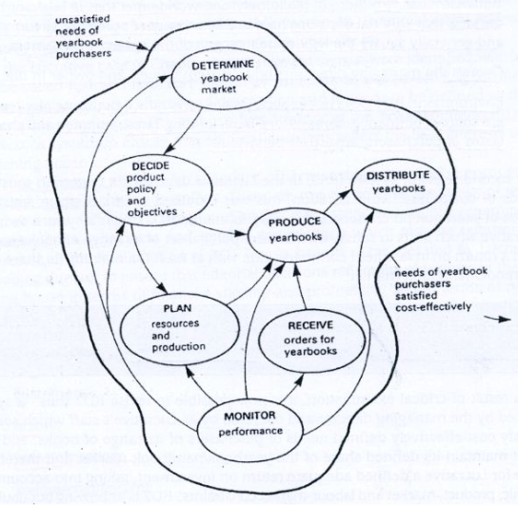
Conceptual model of a notional system for making cost-effective editorial decisions

Slide 15
STEP 4 - Conceptual ModellIng
Key questions
Does the model and its root definition suggest a continuous and relevant mission?
Can performance be measured?
Is a decision-making activiy present?
Do any of the main activities comprise sub-systems of back-up activities?
Do the system components interact?
Does the system interact with an environment?
Does the system have a boundary?
Can the wider system provide resources?
Can the system be sustained?

Slide 16
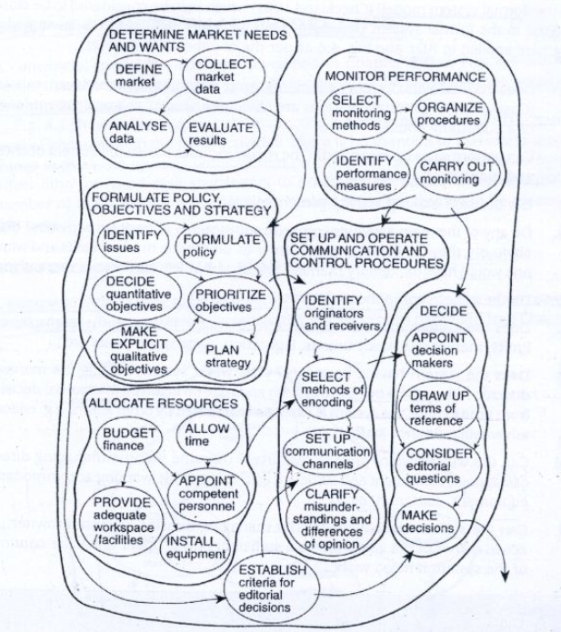
EXPANDED conceptual model of a notional system for making cost-effective editorial decisions

Slide 17
STEP 5 - ComparIsons to ProvIde DebatIng Agenda
Returning to ‘real-world thinking’
Analyst needs to avoid
thinking in terms of real-world practical solutions
In this step, ‘what might be’ (conceptual model) is compared with ‘what is’ (real-world situation from step 2 analysis)
Aim
To illuminate the problem situation analysed in step 2, for both the analyst and the actors, and not the state or suggest that the analyst now knows what must be done

Slide 18
STEP 5 - ComparIsons to ProvIde DebatIng Agenda
Three approaches for comparison
First approach;
Use the conceptual model as a reference and check whether each activity occurs in the real-world situation
Tends to illuminate activities whose existence or absence in the real-world setting is taken for granted, and therefore whose potential contribution to the problem situation may not be recognised
Useful for issue-based problems

Slide 19
STEP 5 - ComparIsons to ProvIde DebatIng Agenda
Second approach;
Imagine the conceptual model in operation in the real world and note all the practical implications
Considering how the same task is actually carried out in the real world
Well-suited to ‘problems’ embedded in primary tasks

Slide 20
STEP 5 - ComparIsons to ProvIde DebatIng Agenda
Third approach;
Uses a template method
What actually happens in the real world is constructed from the rich picture.

Slide 21
STEP 5 - ComparIsons to ProvIde DebatIng Agenda
RESULT of this step
Agenda for debate with actors
AGENDA
List of topics convering mismatches, omissions etc
‘What?’ and ‘Why?’ questions to stimulate the actors’ thinking
It is useful to show actors a ‘sanitized’ version of rich picture of the current situation

Slide 22
STEP 6 - DIscussIng The Agenda WIth The Actors
The most ‘anxious’ stage
Discussion and debate with key roles
Client
Problem owner
Actors identified in the CATWOE test
Analyst’s role is more that of a therapist; he or she may well possess considerable expertise and be capable of recommending solutions

Slide 23
STEP 6 - DIscussIng The Agenda WIth The Actors
Analyst should be prepared for maneuvering and attempts to impose control such as:
‘Well, you’re expert. What’s your answer?’
Analyst is not there to provide practical solutions
Analyst get the actors to examine critically the analyst’s conceptual model of a possible future system

Slide 24
STEP 6 - DIscussIng The Agenda WIth The Actors
Agenda
Should organise and express the analyst’s ideas for possible change
Stemming form rich picture
Root definition
Conceptual model
Comparison
This ideas are not only desirable in system terms but are also compatible with the organization’s culture

Slide 25
STEP 6 - DIscussIng The Agenda WIth The Actors
Aspect of cultural feasibility affect the course of the debate.
Culture is
A complex and dynamic property of human activity systems
A rather nebulous and difficult phenomenon to deal with
Analyst needs to recognize cultural diversity within the organization

Slide 26
STEP 7 - ActIon For Change
Actors possess a list of ‘agreed changes’
‘Whats’ rather than ‘hows’
Converting ‘whats’ into ‘hows‘
If the options are clear : formal problem-solving
For more complex matters : hard systems approach

Slide 27
STEP 7 - ActIon For Change
In principle
the analyst’s task could be complete at the end of step 6
But in practice
continuing or follow-up supoort should be offered
Hidden agendas may surface after agreement which serve to thwart implementation of the changes
Actors may not know how to proceed with practical implementation

Slide 28

Thank you.

